Slide 1
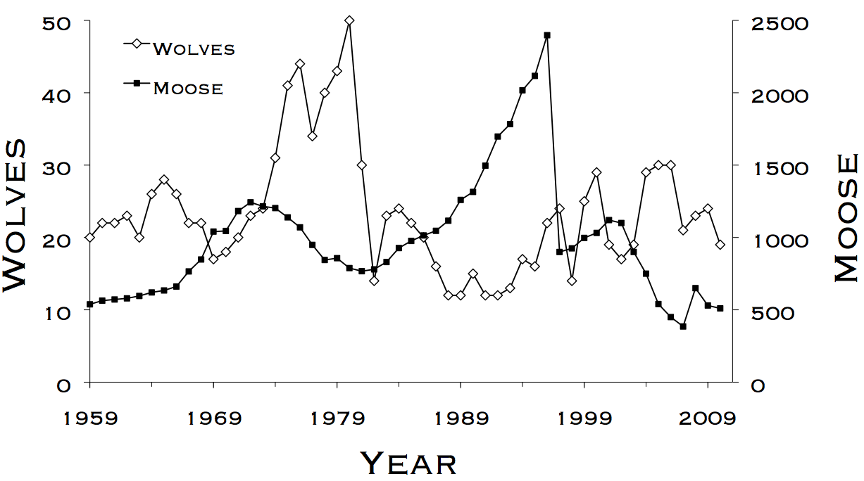
Lab 8 – Stage-based population models
WLE 411, Week 14

Slide 2
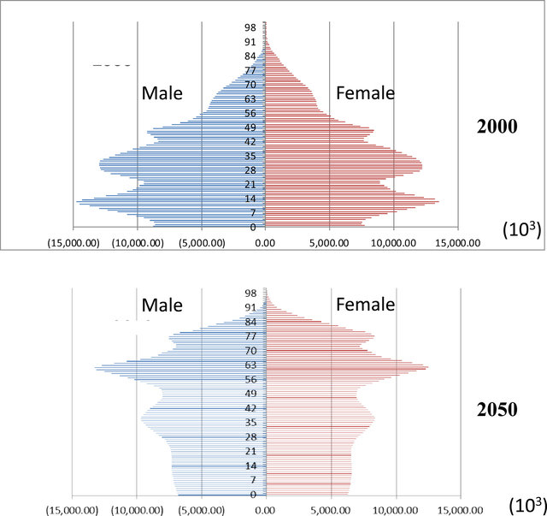
Which national population will grow faster?
China (2000)
China (predicted 2050)
Notes:
The exponential and logistic population models we’ve considered to this point don’t take the age of individuals in the population into account
However, age absolutely matters, which is why modern population models are age-structured

Slide 3
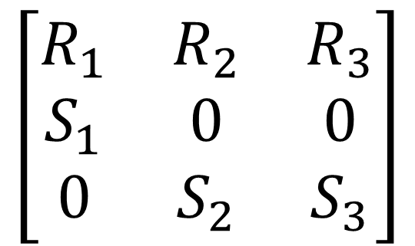
$$\left[\begin{matrix}R_{1} & R_{2} & R_{3} \\ S_{1} & 0 & 0 \\ 0 & S_{2} & S_{3}\end{matrix}\right]$$
Three age classes:
First Year (FY)
Second Year (SY)
Adult
Notes:
Quick review of population growth matrices
3 age classes, 3 columns/rows

Slide 4



Contributions from FY $N_{t}…$
Contributions from Adult $N_{t}…$
Contributions from SY $N_{t}…$
$$\left[\begin{matrix}R_{1} & R_{2} & R_{3} \\ S_{1} & 0 & 0 \\ 0 & S_{2} & S_{3}\end{matrix}\right]$$
Notes:
Quick review of population growth matrices

Slide 5
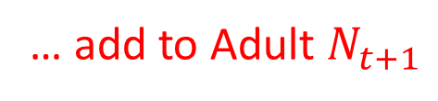
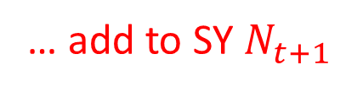
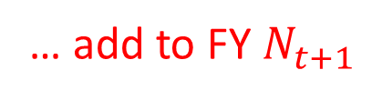
Contributions from FY $N_{t}…$
Contributions from Adult $N_{t}…$
Contributions from SY $N_{t}…$
$$\left[\begin{matrix}R_{1} & R_{2} & R_{3} \\ S_{1} & 0 & 0 \\ 0 & S_{2} & S_{3}\end{matrix}\right]$$
… add to FY $N_{t+1}$
… add to SY $N_{t+1}$
… add to Adult $N_{t+1}$
Notes:
Quick review of population growth matrices

Slide 6
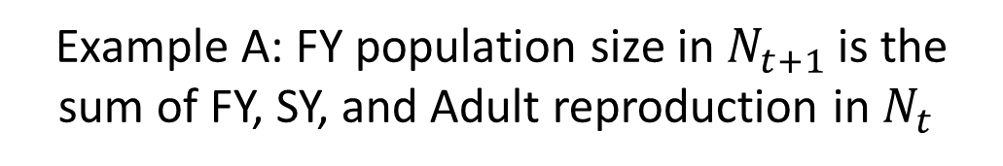
Contributions from FY $N_{t}…$
Contributions from Adult $N_{t}…$
Contributions from SY $N_{t}…$
$$\left[\begin{matrix}R_{1} & R_{2} & R_{3} \\ S_{1} & 0 & 0 \\ 0 & S_{2} & S_{3}\end{matrix}\right]$$
… add to FY $N_{t+1}$
… add to SY $N_{t+1}$
… add to Adult $N_{t+1}$
Example A: FY population size in $N_{t+1}$is the sum of FY, SY, and Adult reproduction in $N_{t}$
Notes:
Quick review of population growth matrices

Slide 7
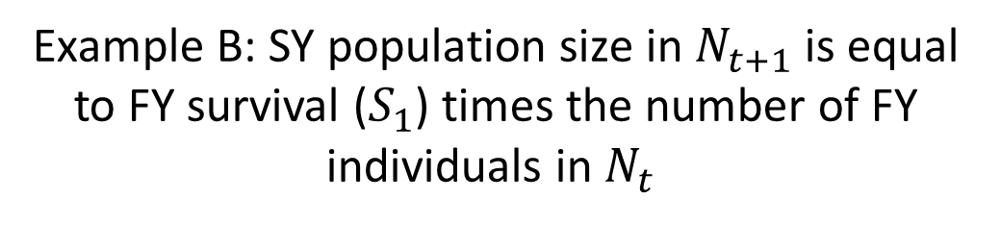
Contributions from FY $N_{t}…$
Contributions from Adult $N_{t}…$
Contributions from SY $N_{t}…$
$$\left[\begin{matrix}R_{1} & R_{2} & R_{3} \\ S_{1} & 0 & 0 \\ 0 & S_{2} & S_{3}\end{matrix}\right]$$
… add to FY $N_{t+1}$
… add to SY $N_{t+1}$
… add to Adult $N_{t+1}$
Example B: SY population size in $N_{t+1}$is equal to FY survival ($S_{1}$) times the number of FY individuals in $N_{t}$
Notes:
Quick review of population growth matrices

Slide 8
What would it look like if the first age class wasn’t reproductive?
Contributions from FY $N_{t}…$
Contributions from Adult $N_{t}…$
Contributions from SY $N_{t}…$
$$\left[\begin{matrix}R_{1} & R_{2} & R_{3} \\ S_{1} & 0 & 0 \\ 0 & S_{2} & S_{3}\end{matrix}\right]$$
… add to FY $N_{t+1}$
… add to SY $N_{t+1}$
… add to Adult $N_{t+1}$

Slide 9
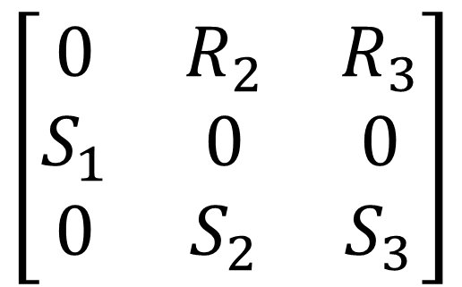
What would it look like if the first age class wasn’t reproductive?
Contributions from FY $N_{t}…$
Contributions from Adult $N_{t}…$
Contributions from SY $N_{t}…$
$$\left[\begin{matrix}0 & R_{2} & R_{3} \\ S_{1} & 0 & 0 \\ 0 & S_{2} & S_{3}\end{matrix}\right]$$
… add to FY $N_{t+1}$
… add to SY $N_{t+1}$
… add to Adult $N_{t+1}$

Slide 10
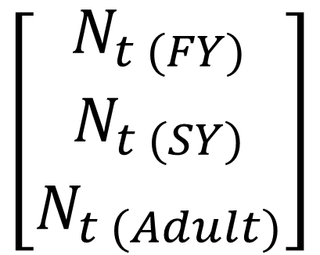
Basics of matrix multiplication
$$\left[\begin{matrix}R_{1} & R_{2} & R_{3} \\ S_{1} & 0 & 0 \\ 0 & S_{2} & S_{3}\end{matrix}\right]$$
$$\left[\begin{matrix}N_{t (FY)} \\ N_{t (SY)} \\ N_{t (Adult)}\end{matrix}\right]$$
x
=
Notes:
Quick review of population growth matrices
3 age classes, 3 columns/rows

Slide 11
Basics of matrix multiplication
$$\left[\begin{matrix}R_{1} & R_{2} & R_{3} \\ S_{1} & 0 & 0 \\ 0 & S_{2} & S_{3}\end{matrix}\right]$$
$$\left[\begin{matrix}N_{t (FY)} \\ N_{t (SY)} \\ N_{t (Adult)}\end{matrix}\right]$$
x
=
Notes:
Quick review of population growth matrices
3 age classes, 3 columns/rows

Slide 12
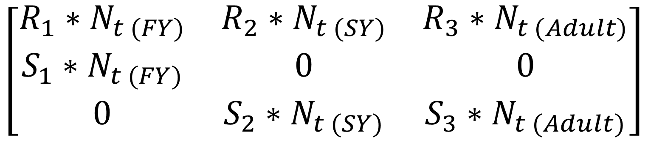
$$\left[\begin{matrix}R_{1} & R_{2} & R_{3} \\ S_{1} & 0 & 0 \\ 0 & S_{2} & S_{3}\end{matrix}\right]$$
$$\left[\begin{matrix}N_{t (FY)} \\ N_{t (SY)} \\ N_{t (Adult)}\end{matrix}\right]$$
x
=
$$\left[\begin{matrix}R_{1}∗N_{t (FY)} & R_{2}∗N_{t (SY)} & R_{3}∗N_{t (Adult)} \\ S_{1}∗N_{t (FY)} & 0 & 0 \\ 0 & S_{2}∗N_{t (SY)} & S_{3}∗N_{t (Adult)}\end{matrix}\right]$$
Notes:
This is how you fill in the population model in your excel spreadsheet

Slide 13
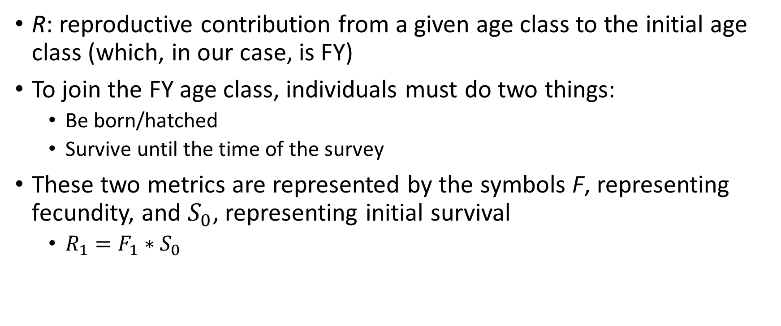
What goes into the R term?
R: reproductive contribution from a given age class to the initial age class (which, in our case, is FY)
To join the FY age class, individuals must do two things:
Be born/hatched
Survive until the time of the survey
These two metrics are represented by the symbols F, representing fecundity, and $S_{0}$, representing initial survival
$R_{1}=F_{1}∗S_{0}$
Notes:
Fecundity x Survival

Slide 14
Final notes
This lab can be done on Mac computers (doesn’t require MARK)
Extra credit is available for this lab
Translate Part 3 from Excel to R

